Slide 1
Unreal advanced
multiplayer

Slide 2
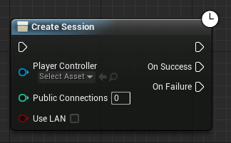
Create session
The Create Session node is where everything starts. Once your game has successfully created a session, other instances of your game will be able to discover it (using the Find Session node) and then join it (using the Join Session node). On this node, you can specify the number of players allowed in the session and whether the session should be created in LAN mode. For online subsystem modules that support it, setting LAN mode to false will attempt to create an Internet game.

Slide 3
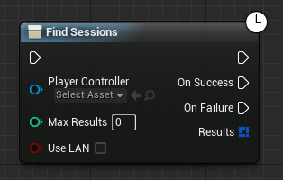
Find Sessions
Use the Find Sessions node to get a list of game sessions that are currently being advertised and joinable. The BlueprintSessionResult objects returned from a successful call will allow you to get the server's name, ping, and player counts.

Slide 4
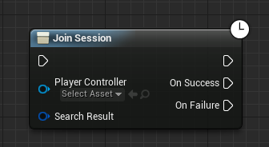
Join Session
Once you know which BlueprintSessionResult you would like to join, pass it into a Join Session call. If the game successfully connects to the server, it will automatically travel to the server's map and join gameplay.

Slide 5
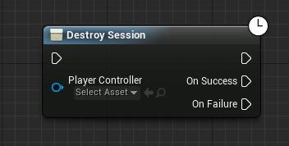
Destroy Session
When you no longer want other players to be able to discover and join your game, you can call the Destroy Session node. This will effectively cause you to leave the session, and if you are the host, shut down the session so that it is no longer discoverable.

Slide 6
Error Handling Nodes
Unfortunately, when dealing with network operations, errors are always a possibility and game should handle them gracefully. Perhaps the host of the session you try to join has just quit a moment earlier, or perhaps your internet service went down temporarily, or any number of other problems occur. Through Blueprints, your games have more flexibility in how they handle these network-related errors.
Failures that originate from the Session Operations described above will be reported through the OnFailure execution pin, so you can set up your game to handle these failures as you wish. For certain kinds of failures however, or failures that occur in the middle of gameplay, there are a couple of Error Events that can be called within a GameInstance Blueprint, Network Error and Travel Error.

Slide 7

Error Handling Nodes

Slide 8
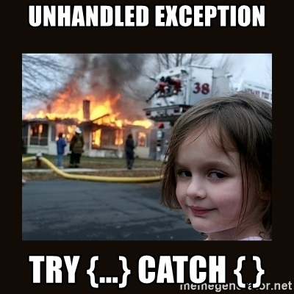
Error Handling Nodes

Slide 9
Error Handling Nodes
Network Error
Travel Error

Slide 10
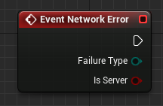
Event Network Error
The Network Error Event allows games to respond to the event, receive an enumeration value that describes the type of error, and respond appropriately - a game may want to display a dialog box to the user, for example.

Slide 11
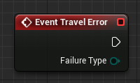
Event Travel Error
The Travel Error Event, which is less common than the Network Error Event, allows games to handle cases such as trying to load an invalid map, which are not covered by Network Error.

Slide 12
HOMEWORK
Finish past homework!!!!!!!!!!!!!!!!!!!!!!!!!!

Slide 13
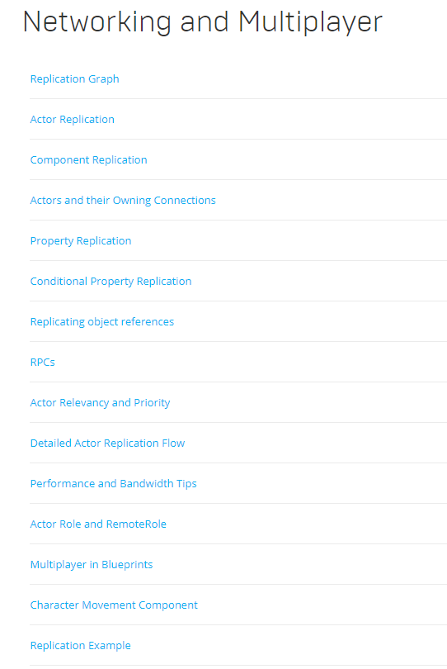
Documentation

Slide 14
reference
https://docs.unrealengine.com/en-us/Engine/Blueprints/UserGuide/OnlineNodes
https://docs.unrealengine.com/en-us/Gameplay/Networking
https://docs.unrealengine.com/en-US/Gameplay/Networking/Server
https://www.youtube.com/watch?v=abmzWUWxy1U&list=PLZlv_N0_O1gYqSlbGQVKsRg6fpxWndZqZ

Slide 15
Source
https://github.com/Koous61/unreal-course

